Slide 1





Multitasking
Executing multiple task at the same time.

Slide 2
Type of Multitasking
Process based Multitasking
Thread based Multitasking

Slide 3
Process Based Multitasking
Executing multiple task at the same time where each task is a separate independent program(process), is called process based multitasking. It is suitable for Operating System level.

Slide 4
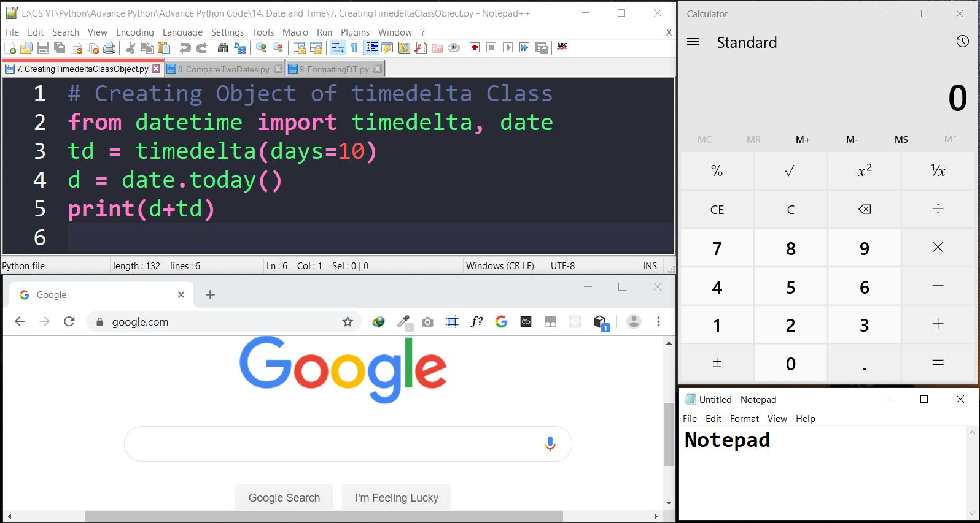

Slide 5
Thread Based Multitasking
Executing multiple task at the same time where each task is a separate independent part of the same program(process), is called Thread based multitasking and each independent part is called Thread. It is suitable for Programmatic level.
Ex: - MS Word

Slide 6
Thread
Thread is a separate flow of execution. Every thread has a task.

Slide 7


Flying Thread
CallAuntyMay Thread
Watching MJ Thread
Doc Thread

Slide 8
Multithreading
Using Multiple Threads in program or process
The main important application areas of multi threading are:
Multimedia Graphic
Animations
Video Games
Web Servers
Application Servers

Slide 9





Slide 10
Main Thread
When we start any Python Program, one thread begins running immediately, which is called Main Thread of that program created by PVM.
The main thread is created automatically when your program is started.
import threading
t = threading.current_thread().getName()
print(t)

Slide 11
Creating a Thread
Thread class of threading module is used to create threads. To create our own thread we need to create an object of Thread Class.
Following are the ways of creating threads:-
Creating a thread without using a class
Creating a thread by creating a child class to Thread class
Creating a thread without creating child class to Thread class

Slide 12
Creating a thread without using a class
from threading import Thread
thread_object = Thread(target=function_name, args=(arg1, arg2, …))
thread_object – It represents our thread.
target – It represents the function on which the thread will act.
args – It represents a tuple of arguments which are passed to the function.
Ex:-
t = Thread(target=disp, args=(10,20))

Slide 13
How to Start Thread
Once a thread is created it should be started by calling start() Method.
from threading import Thread
def disp(a, b):
print(“Thread Running:”, a, b)
t = Thread(target=disp, args=(10, 20))
t.start()
from threading import Thread
def disp(a, b):
print(“Thread Running:”, a, b)
for i in range(5):
t = Thread(target=disp, args=(10, 20))
t.start()
Starting Thread
Starting Thread

Slide 14
from threading import Thread
def disp():
for i in range(5):
print(“Child Thread”)
t = Thread(target=disp)
# upto here there is only one thread – Main Thread
# All the above code executed within Main Thread
t.start()
# Once we start Child thread, there are now Two Threads – Main Thread and Thread-1
# Child Thread is responsible to run disp method
# and below code will be run by Main thread
for i in range(5):
print(“Main Thread”)
Main thread is responsible to create and Start Child Thread, once the child thread has started both the thread behave separately.

Slide 15
Set and Get Thread Name
current_thread() – This function return current thread object.
getName() – Every thread has a name by default, to get the name of thread we can use this method.
setName(name) – This method is used to set the name of thread.
name Property – This property is used to get or set name of the thread.
Ex:-
thread_object.name = ‘String’
print(thread_object.name)

Slide 16
Creating a thread by creating a child class to Thread class
We can create our own thread child class by inheriting Thread Class from threading module.
class ChildClassName(Thread):
statements
Thread_object = ChildClassName ()
Ex:-
class Mythread(Thread):
pass
t = Mythread()

Slide 17
Thread Class’s Methods
start ( ) – Once a thread is created it should be started by calling start() Method.
run( ) – Every thread will run this method when thread is started. We can override this method and write our own code as body of the method. A thread will terminate automatically when it comes out of the run( ) Method.
join ( ) – This method is used to wait till the thread completely executes the run ( ) method.

Slide 18
Thread Child Class with Constructor
from threading import *
Class Mythread(Thread):
def __init__(self, a):
Thread.__init__(self)
self.a = a
t = Mythread(10)
Thread Class as Parent Class
Calling Thread Class Constructor

Slide 19
Creating a thread w/o creating a child class to Thread class
We can create an independent thread child class that does not inherit from Thread Class from threading module.
class ClassName:
statements
object_name = ClassName ()
Thread_object = Thread(target=object_name.function_name, args=(arg1, arg2,…))
Ex:-
class Mythread:
def disp (self, a, b): print(a, b)
myt = Mythread()
t = Thread(target=myt.disp, args=(10, 20))
t.start()

Slide 20
Single Tasking using a Thread
When multiple tasks are executed by a thread one by one, then it called single tasking.
Writing Examination
Question 1
Question 2
Question 3

Slide 21
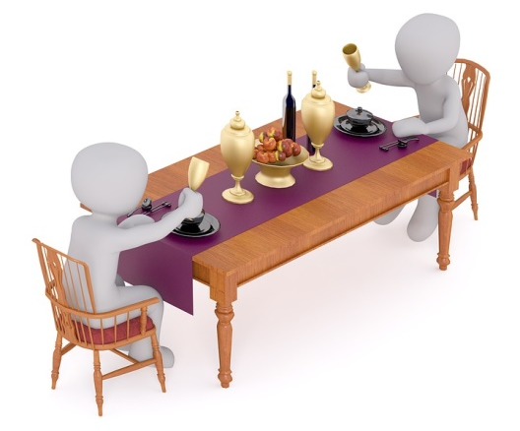


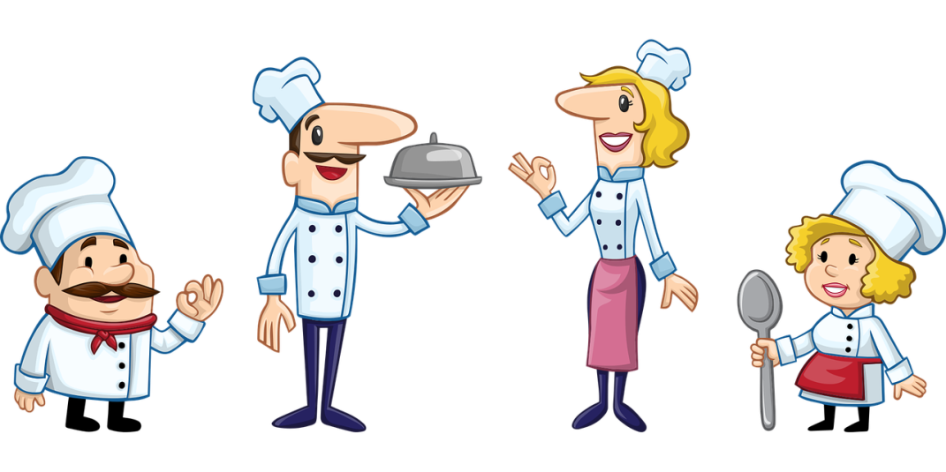
Multitasking using Multiple Thread
When multiple tasks are executed at a time, then it is called Multi-tasking. For this purpose we need more than one thread and when we use more than one thread, it is called multi threading.

Slide 22

Multitasking using a Multiple Thread
When multiple tasks are executed at a time, then it is called Multi-tasking. For this purpose we need more than one thread and when we use more than one thread, it is called multi threading.

Slide 23
Race Condition
Race condition is a situation that occurs when threads are acting in an unexpected sequence, thus leading to unreliable output.
This can be eliminated using thread synchronization.

Slide 24
Thread Identification Number
Every thread has an unique identification number which can be accessed using variable ident.
Syntax:- Thread_object.ident
Ex:- t.ident

